Slide 1

MEMBERS
Luis Alberto Erazo Ramos
Yesid Montaño Cuero
Johan Sebastián Valencia Díaz
Maria Angélica Velasco
Leidy Johana Castillo Meneses
Sebastián Díaz Moreno
BUBBLEBOT
PROYECT

Slide 2
ABSTRACT
In order to strengthen our capabilities in the field of programming, we has decided to carry out a project related to our professional field. In this case, the load distribution. This project will be carried out with the possibilities that Fischertechnik gives, and its programming language, RoboPRO. Initially, the team aimed to build a manual handling robot to carry out activities related to the transportation and distribution of load. However, when the members of the group increased, the idea was reconsidered. Finally, our project consists of a load distribution car that will operate inside a plant, which will have autonomous and manual handling.

Slide 3

KEY WORDS
Automation
Programming
Robotics
Simulation

Slide 4

PURPOSE OF THE INVESTIGATION
Our interest has been set in the system of distribution of loads within the plant of an industry. For this reason, we have decided to improve the system by creating a scale model of a car that allows to transport products in order to shorten the time of the execution of this task.

Slide 5


JUSTIFICATION
The present project is carried out in order that the members of the group acquire and apply skills in programming, robotics, simulation and automation. All this through the design and execution of a robot car that has the ability to identify objects and colors. This robot will be automaton in these actions, and in certain cases guided manually.

Slide 6
OBJECTIVES
GENERAL
Make a car, that will works both manual and automatic, that works within the industry. In this project all the knowledge learned during the VIP course process will be applied.
SPECIFIC
Build and program a car that makes it possible to increase efficiency in the task of load distribution within an industry.
Complement and strengthen the skills learned in the VIP course through practice.
In the long term, implement a differentiating factor in the project that makes it stand out from other options.

Slide 7
METHODOLOGY
INSIDE THE PROYECT:
Advances are handled by specific objectives.
The construction of the automobile, both physical and algorithmic, is based on trial and error.
TEAMWORK:
Conduct extracurricular group meetings in order to advance the project.
Each member of the group will not have any specialization, all the integrants will be multifunctional.
When the team members cannot meet, each member contributes to the progress of the project, and later communicates it to the rest of the group.

Slide 8
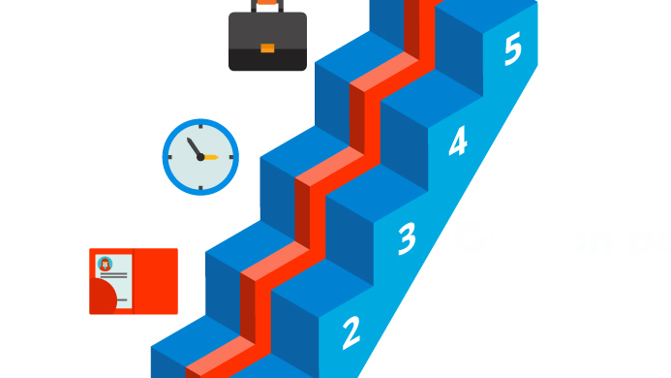
EXPECTED RESULTS
The car works automatically and manually.
The car is capable of fulfilling its function of transporting objects and depositing them properly in an established place.
The car manages to identify objects through colors, in addition to detecting obstacles that appear along the way.

Slide 9
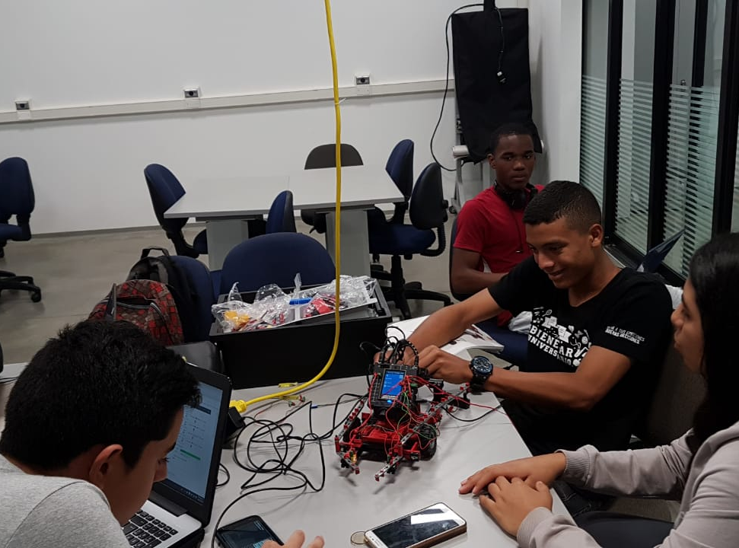
WIP

Slide 10
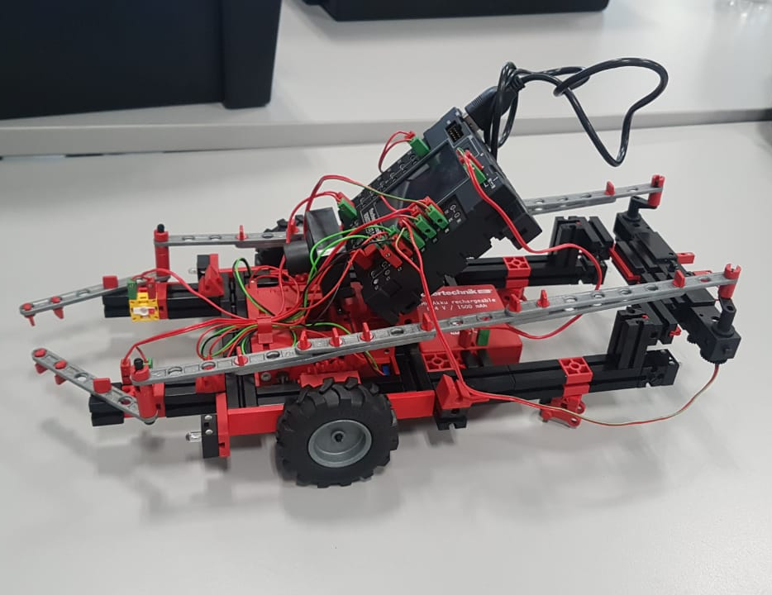
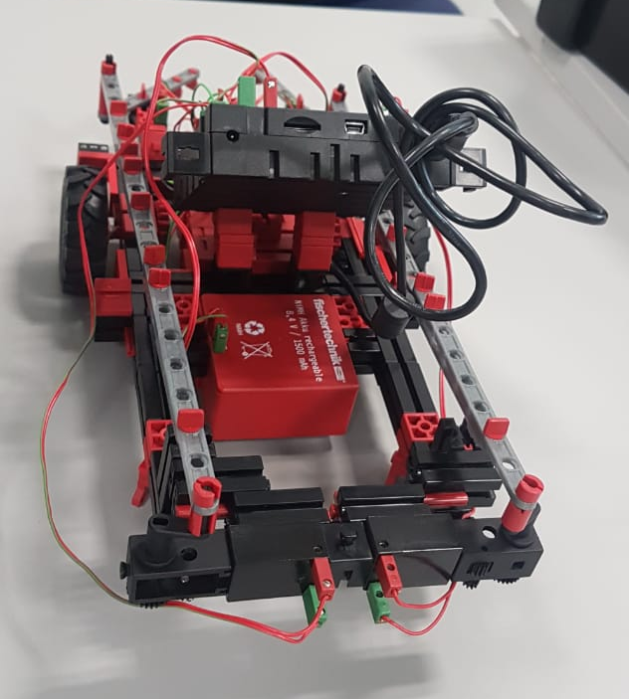
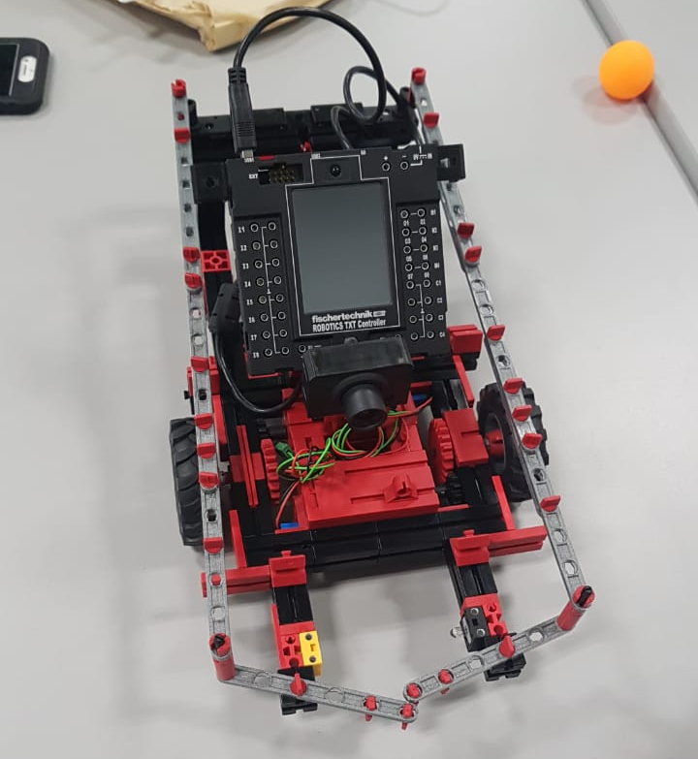
WIP

Slide 11
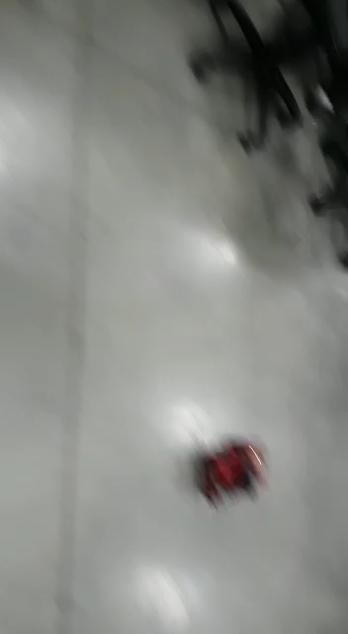
WIP

